Slide 1
Zurich
Single Lock-In
Lee Jong Geon

Slide 2
Last Points
MATLAB
MathoWork 지원팀에 직접 연락
MathWorks Technical Support Department, 윤우식 답변
Parallel programmin의 경우 core↑ ➔ performance ↑
CPU는 single precision, double precision의 performance 변화가 크지 않다.
CPU의 hyper-threading으로 만들어진 virtual core이 MATLAB에 끼치는 영향은 매우 작다.
GPU는 MATLAB version (R2017a, R2018a, etc.)에 따라 선택➔학교 최신버전 제공

Slide 3
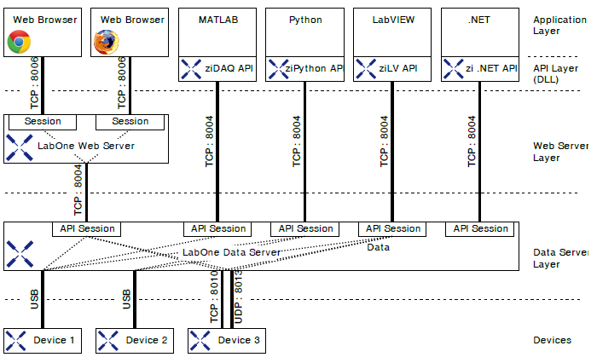
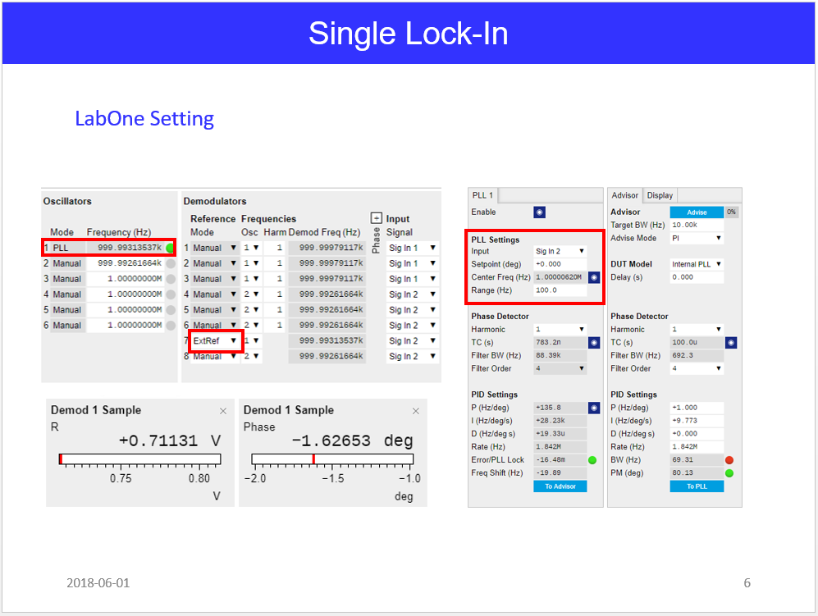
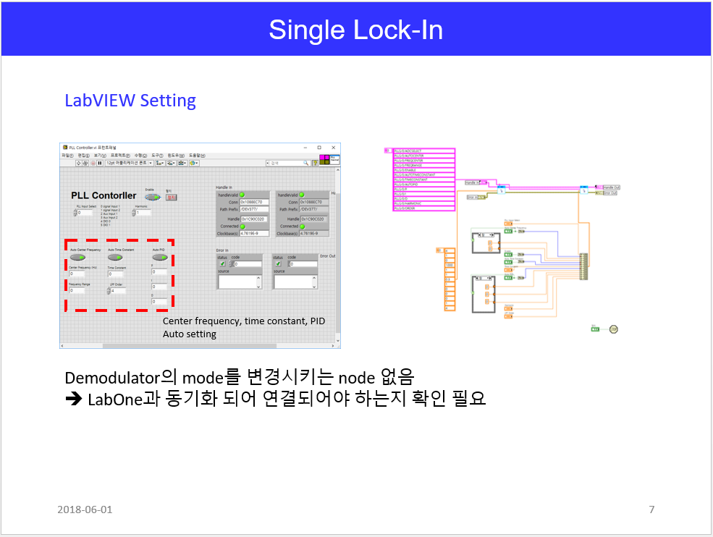
Last Points
Zurich LabOne - LabVIEW
➔ 독립적인 Interface

Slide 4
Single Lock-In
Device Connection
Function generator로 ext. reference와 input signal을 구현
Function Generator
(External reference)
output
Signal
Zurich HF2LI
Ext.
Reference
Input 1
Output 1
Input 2
Output 2

Slide 5
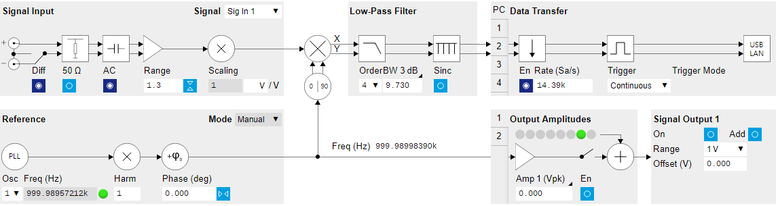
Single Lock-In
Diagram

Slide 6
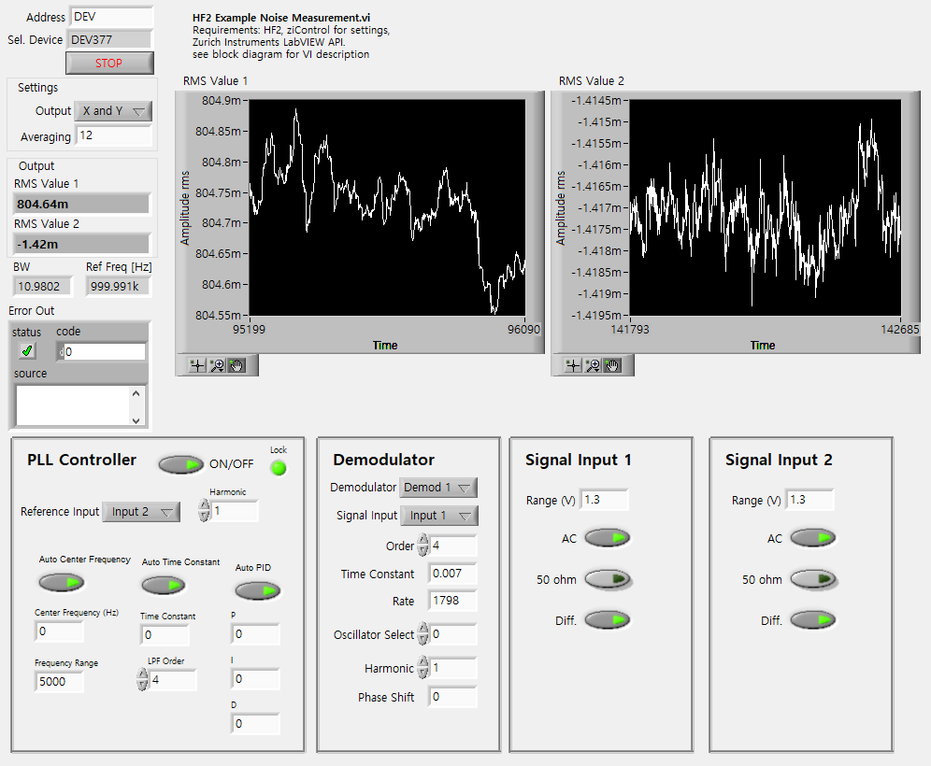
Single Lock-In (LabVIEW)

Slide 7
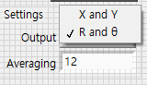
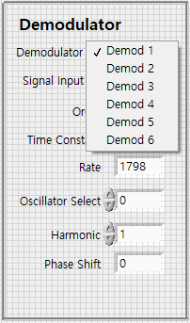
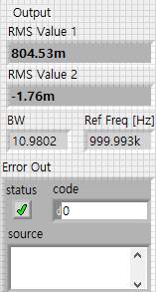

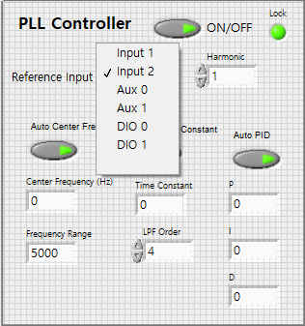
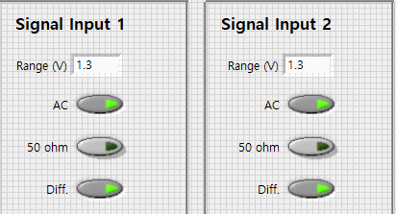
Single Lock-In (LabVIEW)
Display Settings
Demodulator Settings
Output
PLL Settings
Input Settings

Slide 8
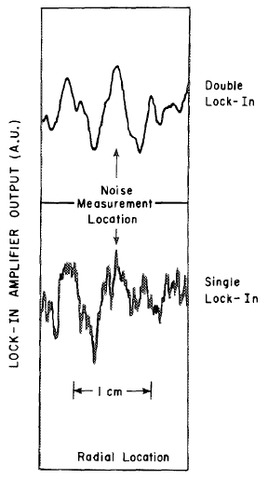
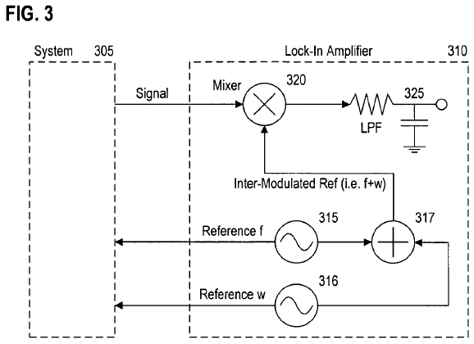
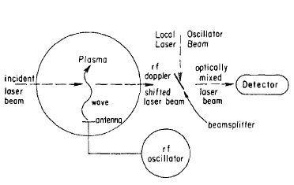
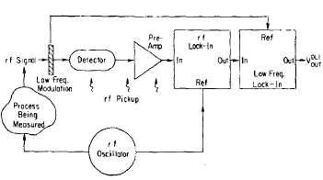


Dual Lock-In
Patent Data
Paper
$$f_{1}=12.5MHz, f_{2}=520Hz$$
$$τ_{1}=500μs, τ_{2}=4s$$
$$\frac{SNR^{DLI}}{SNR^{SLI}}≅20$$
U.S. Patent No. US 7590196 B2. (2005). Washington, DC: U.S. Patent and Trademark Office.
Review of Scientific Instruments 56, 1662 (1985); doi: 10. 1063/1.1138121

Slide 9
Week Plan
 | May 5th wk. | June 1st wk. | June 2nd wk. | June 3rd wk. | June 4th wk.
PLL
Single LI Scope & Test
Dual LI Mixer Design
Dual LI Scope & Test

